Slide 1
DIVE INTO CODE
Machine Learning Engineering Course
GRADUATION ASSIGNMENT
October 2021
Self Introduction
Research Topic
Method Model

Slide 2
SELF INTRODUCTION
Hello I am Santigie B Kamara a final year computer science student at “UNIMTECH UNIVERSITY” Sierra Leone.
I am a Sierra Leonean by nationality, working as a chief engineering officer at the Global Developers network SL. Limited.

Slide 3

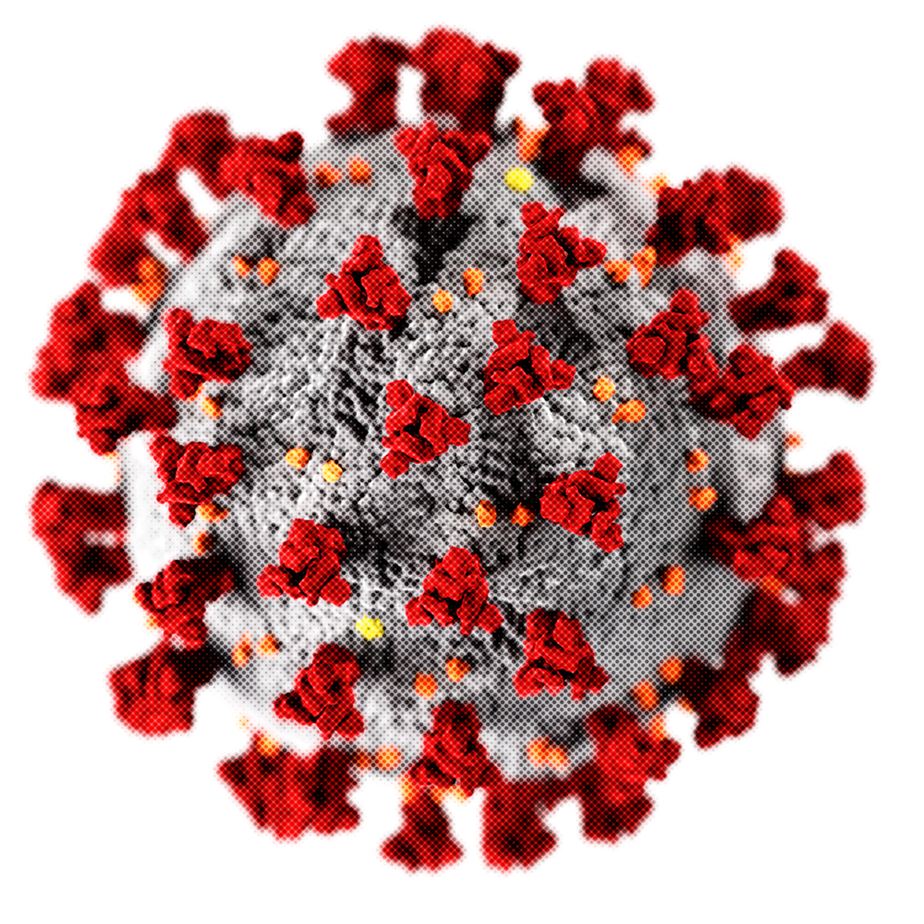
COVID-19 DEATH RATE IN SIERRA LEONE
RESEARCH TOPIC

Slide 4
EFFECT OF COVID-19 IN SIERRA LEONE
Effects of COVID-19 combined with the lean season and forecast heavy rains to further deteriorate the food security situation. The effects of COVID-19 triggered reduced purchasing power and employment opportunities, which are expected to further exacerbate the food security situation, especially during the lean season (June– august). Forecast heavy rains, flash floods and mudslides are also expected in coastal areas. Furthermore, animal health capacities are weak and mostly dependent on partners’ support to prevent seasonal outbreaks, including peste des petits ruminants in sheep and goats, foot-and-mouth disease in cattle and newcastle disease in poultry. About 4 million people are facing stress conditions (phase 2) and are at risk of slipping into worse levels of food insecurity, if the necessary safety nets are not in place.

Slide 5
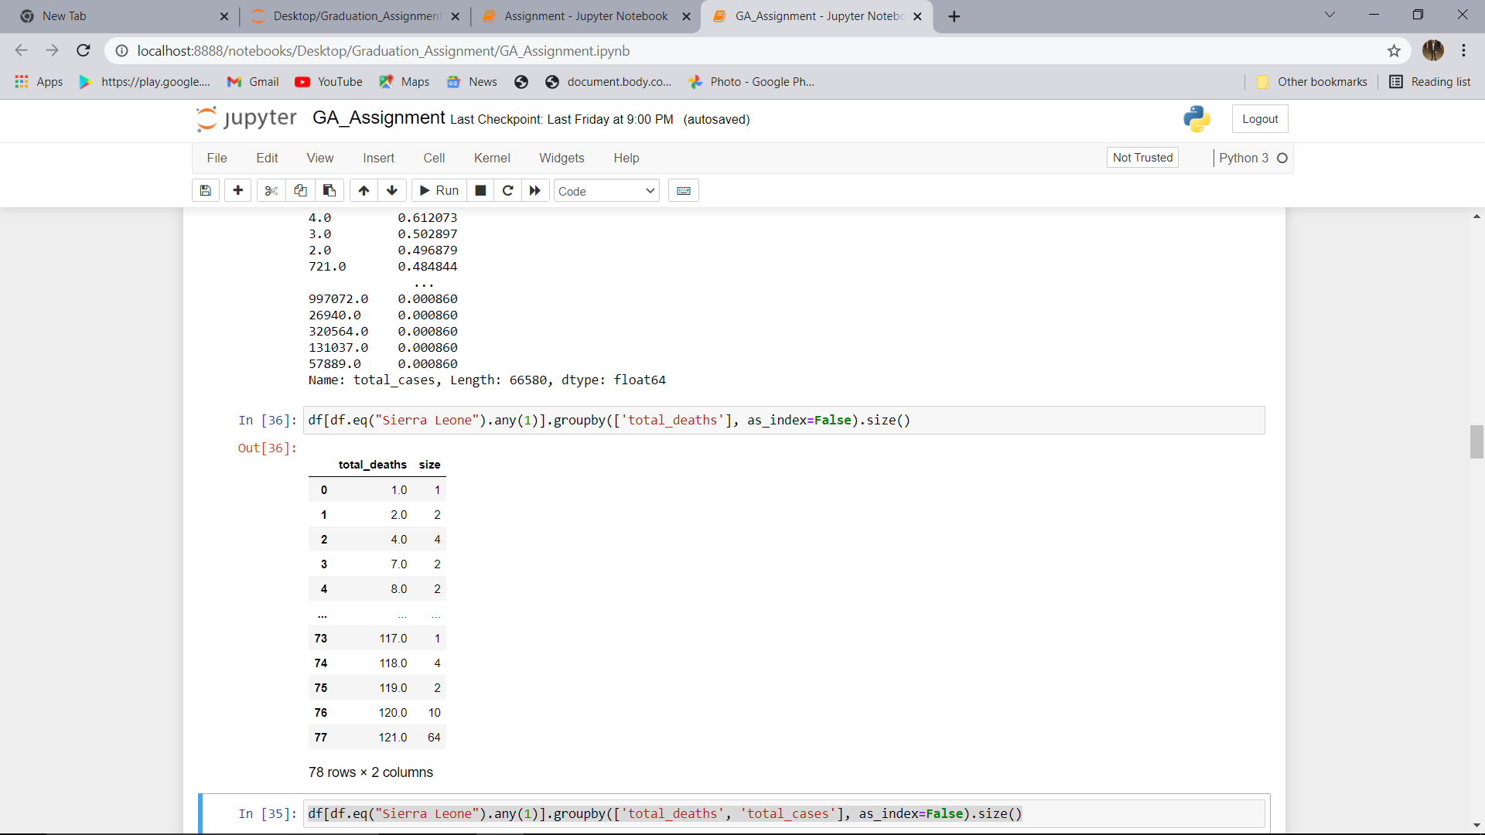
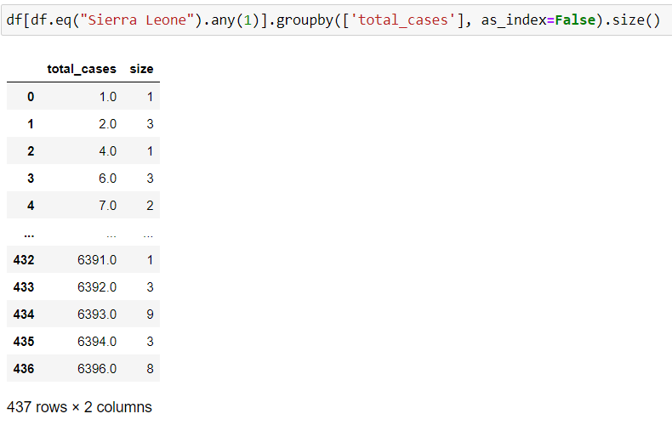
MODULES
DEATH CASES
CONFIRM CASES

Slide 6
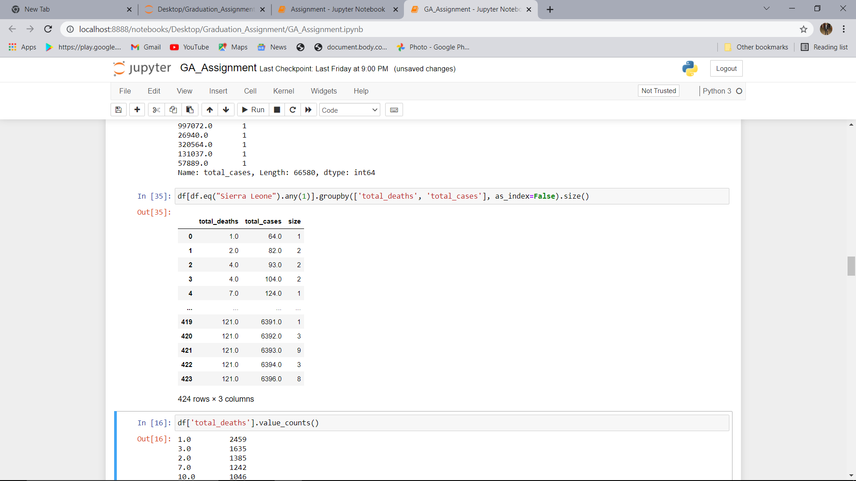
Total death cases and total confirm cases

Slide 7
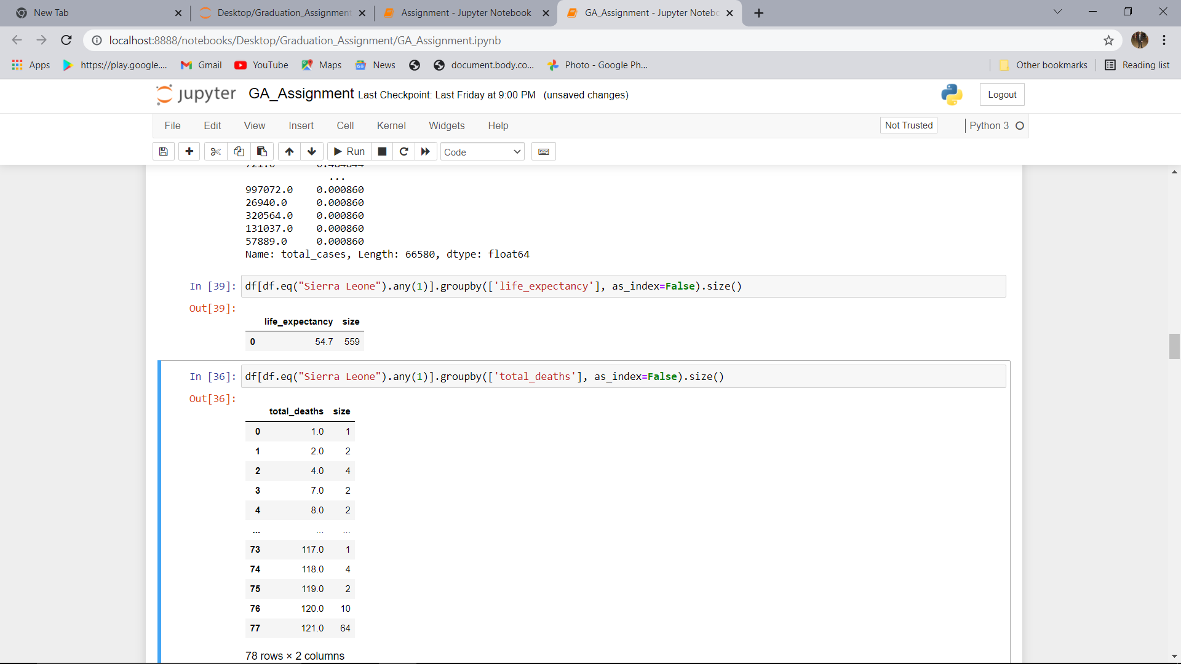
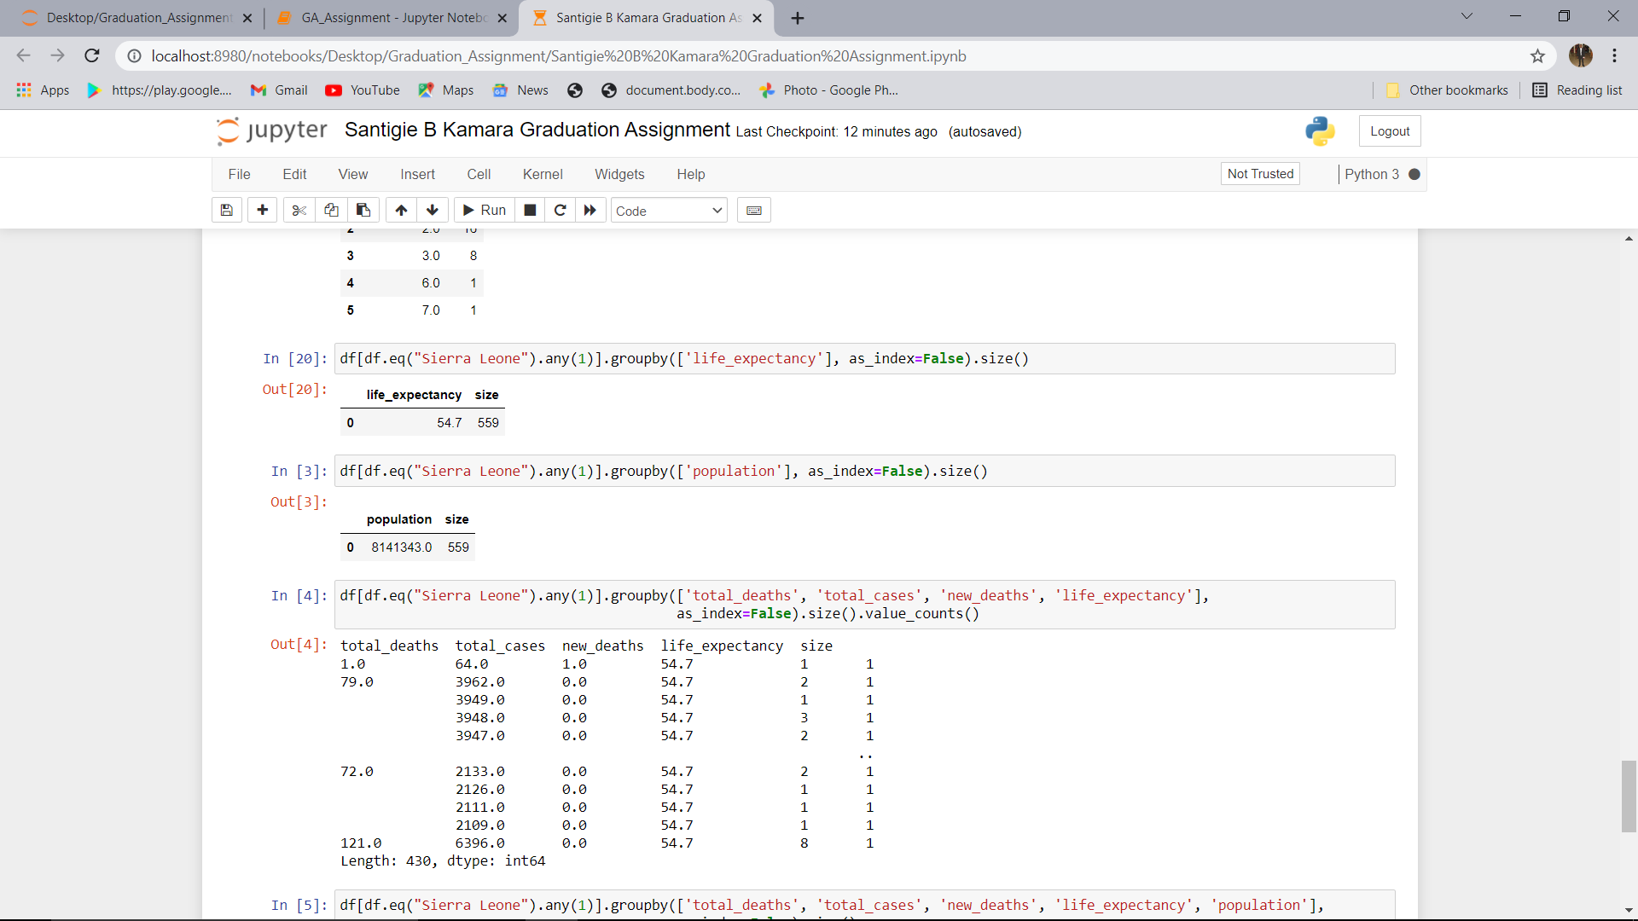
Life Expectancy Rate in Sierra Leone
Population

Slide 8
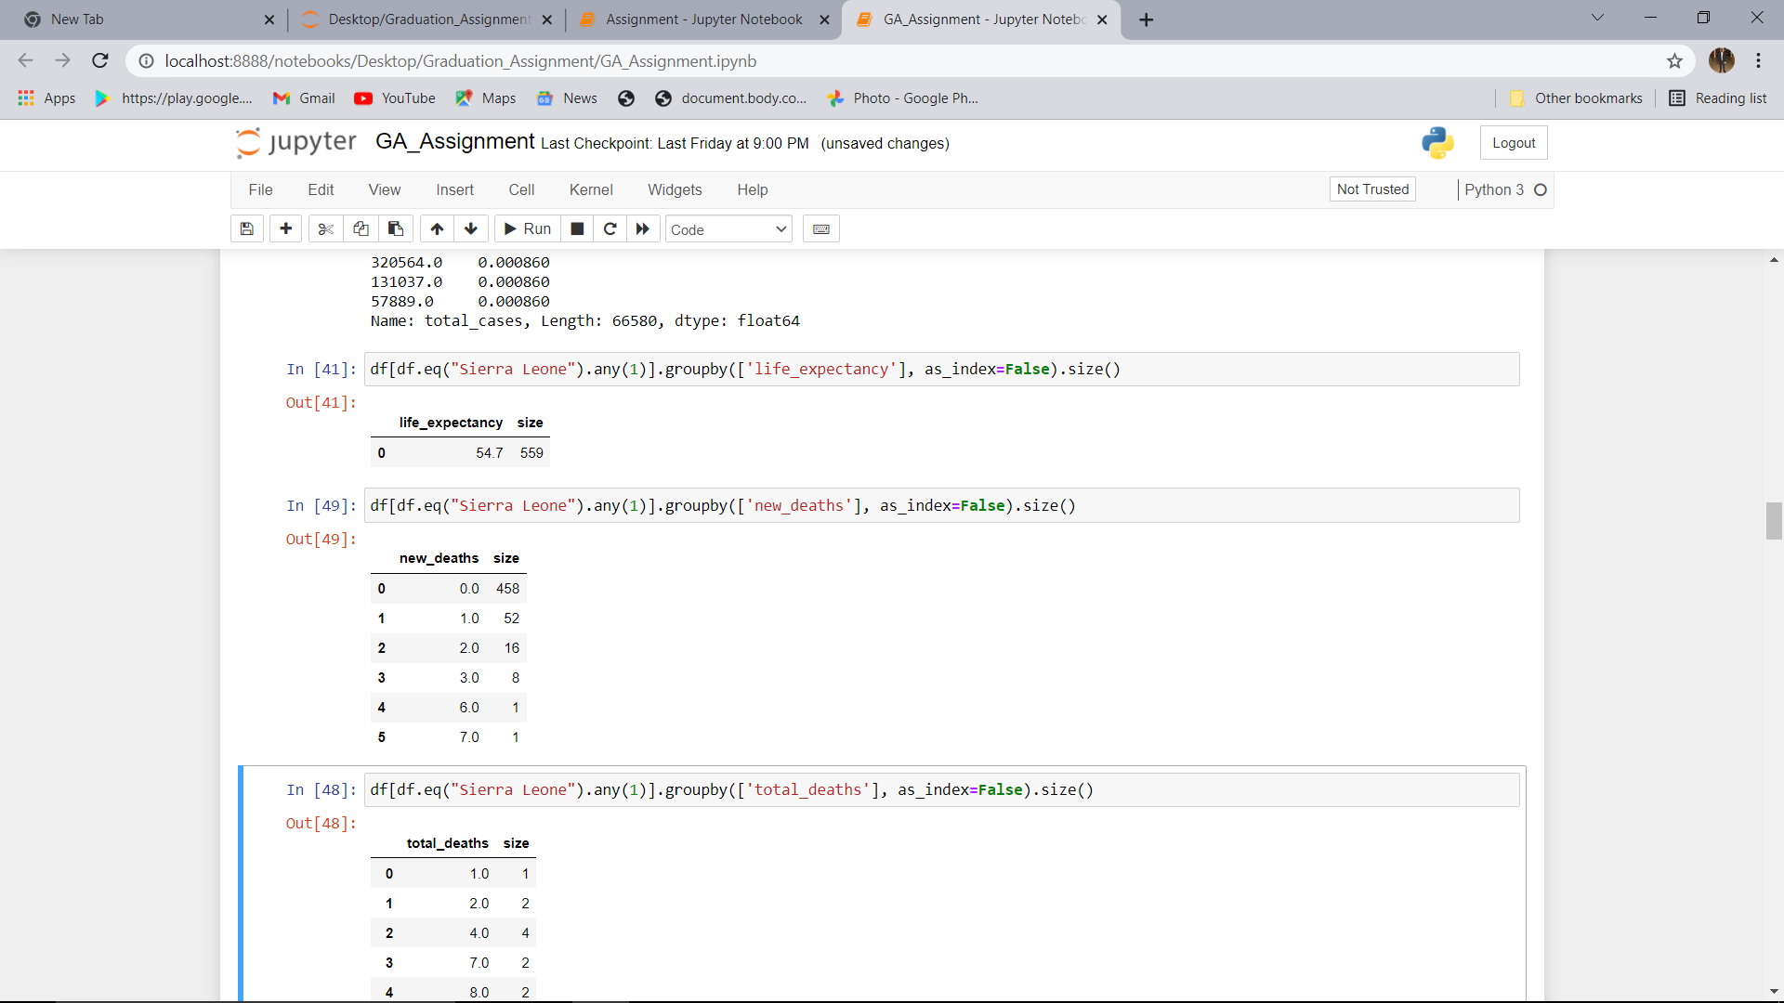
New Confirm Death Cases

Slide 9
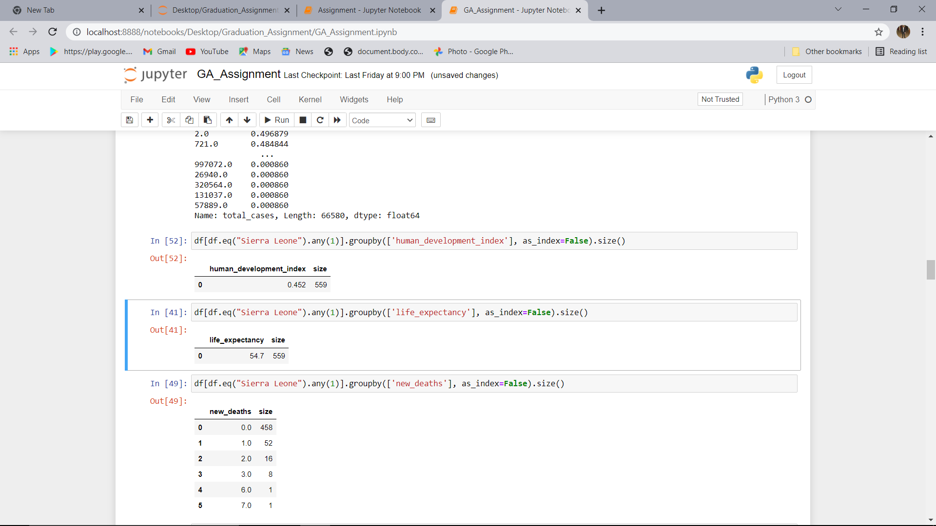

Slide 10
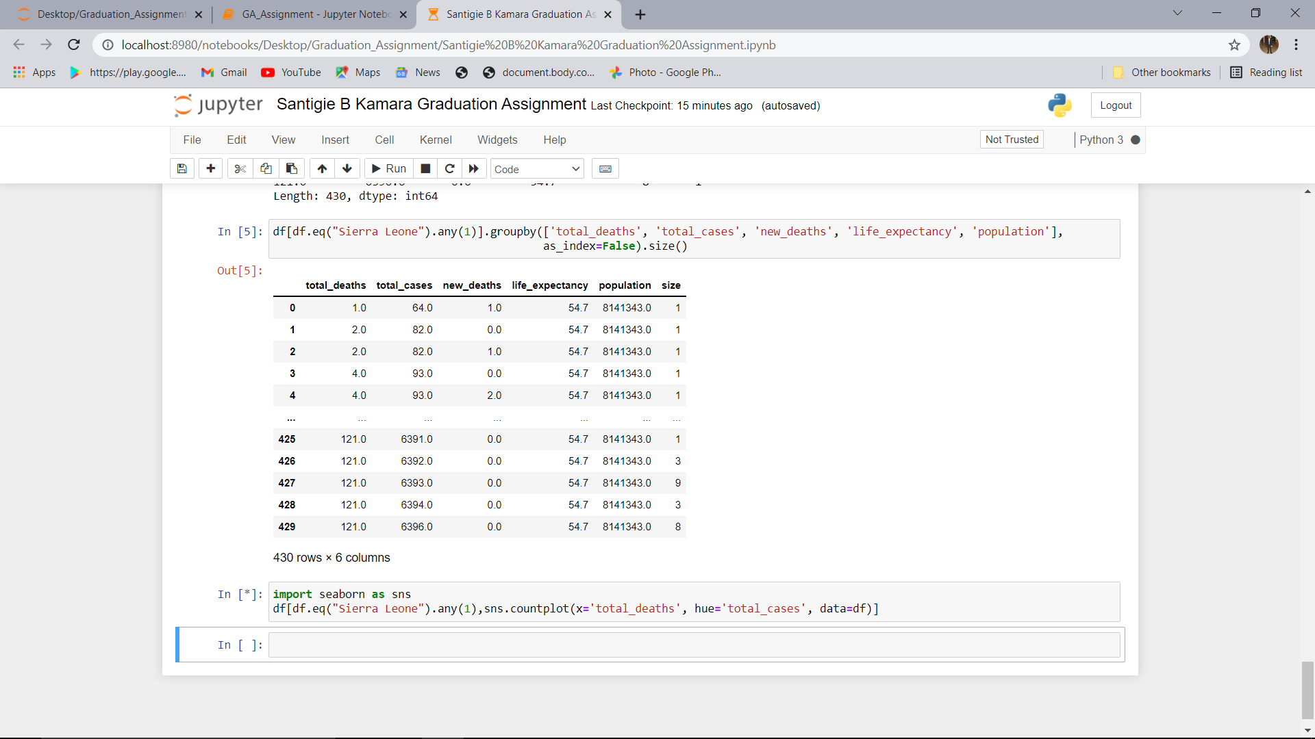

Slide 11
Thank you so much for your attention
Santigie B. Kamara Graduation Assignment
Presented by Santigie B Kamara

